Slide 1



Steven D. Reeves
Certified Cloud Pak Engineer
Data Scientist – (NLP) Text Analytics Specialist
Distribution Market
sdreeves@us.ibm.com
SPSS Modeler Text Analytics
Let’s simplify your information architecture
and put your data to work
Forrester Wave Leader
Enterprise Insights Platform, 2020
Experience 20 years – Research & Practice – Computational Linguistics within applied Data Science – Xerox PARC/IBM Research - InXight Software, Business Objects, SAP (Hana) – SPSS – IBM
Guest Lecturer – College of William and Mary - UVA
Notes:
We need to create the envelopes that make us look like a $500M company. Let everyone else tuck into that envelope, we can create a whole that is greater than the sum of its parts.- Wally

Slide 2
Steven D. Reeves
Certified Cloud Pak Engineer
Data Scientist – (NLP) Text Analytics Specialist
Distribution Market
sdreeves@us.ibm.com
SPSS Modeler Text Analytics
Let’s simplify your information architecture
and put your data to work
Forrester Wave Leader
Enterprise Insights Platform, 2020
Notes:
We need to create the envelopes that make us look like a $500M company. Let everyone else tuck into that envelope, we can create a whole that is greater than the sum of its parts.- Wally

Slide 3
Data Science on Unstructured Data with Watson Studio on Cloud Pak for Data
Steven D. Reeves
Data Scientist – Text Analytics Specialist
Distribution Market
sdreeves@us.ibm.com

Slide 4
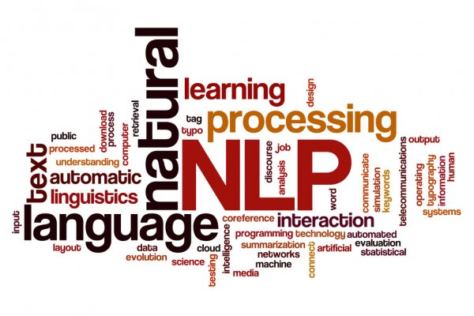
Purpose of todays meeting:
A highly abbreviated version of my SPSS Modeler Premium Workshop Class… customers, partners, internal, university settings…
Highly Recommended: Hands on Repetition…
Learn the fundamentals of using SPSS Modeler Premium Text Analytics and apply the base knowledge to CPD.

Slide 5
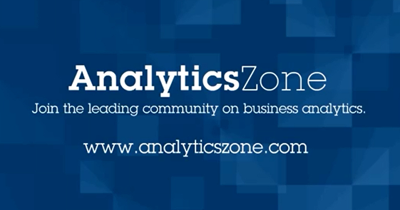
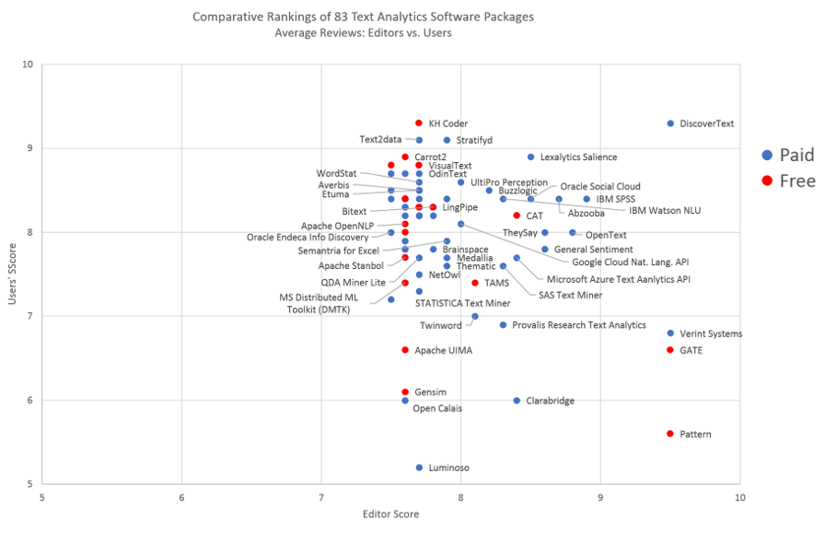
CRISP-DM - the data mining process methodology that describes commonly used approaches that data mining experts use to tackle business problems.
Common Questions I receive…
Both IBM and Clients!!!
I have Unstructured Data
What do I do first?
Industry:
Where do I start?
What tool do I choose?
Open Source?
Vendor?
Watson Studio
CPD
Cloud
DeskTop
NLTK
Watson NLU
Watson Knowledge Studio
Discovery
SPSS Modeler TA
Client/Server
Watson Studio Service
Notes:
Here is what is on deck for today.

Slide 6
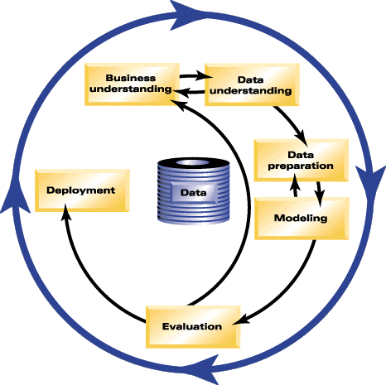
CRISP-DM - the data mining process methodology that describes commonly used approaches that data mining experts use to tackle business problems.
The methodology to answer the questions…
Cross-Industry Standard Process for Data Mining
Enterprise Content Management
Analytics
Predictive Analytics
Machine Learning
Survey Analysis
Social Media
Net Promoter Scores
Etc.
Chat Bots
Search
NLP Request Response API
UIMA
Others…
Churn
noun \ˈchərn\
Simply capture the amount of turnover in your customer base over a period of time.
Notes:
Here is what is on deck for today.

Slide 7
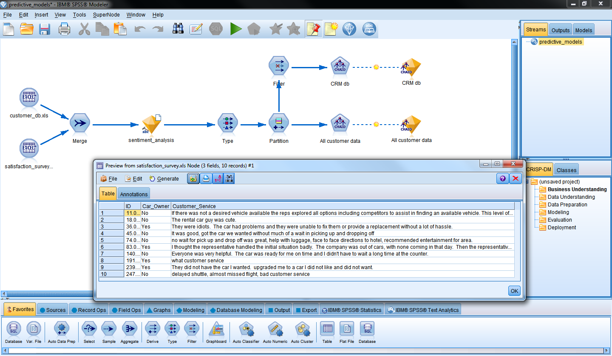
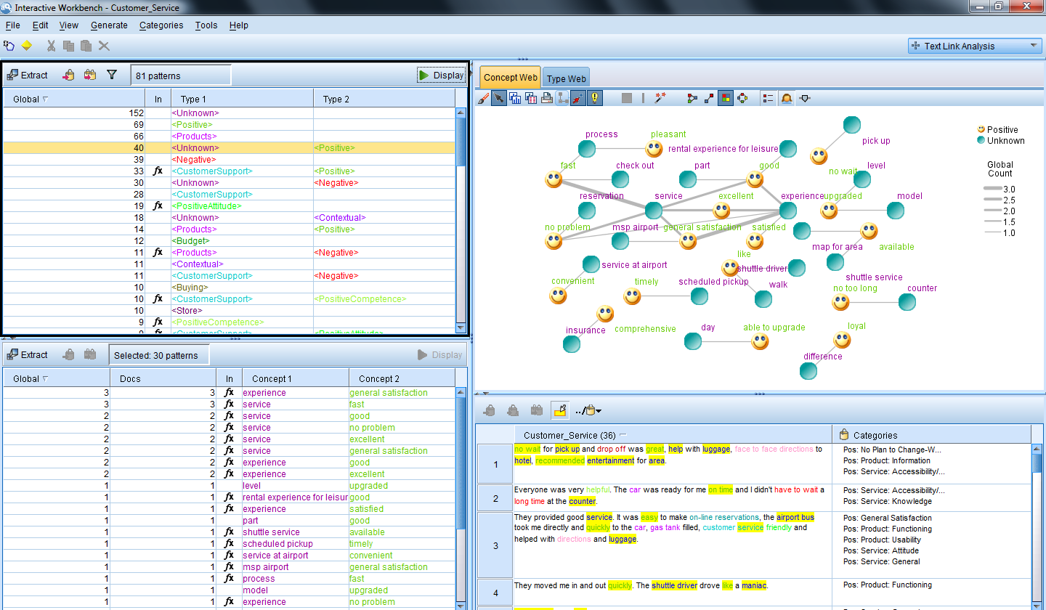
A Classic NLP Engine designed to turn unstructured data into structured data to create Independent Variables for Predictive Analytics and Machine Learning Models.
What is it…
SPSS Modeler Premium Text Analytics:
Churn
noun \ˈchərn\
Simply capture the amount of turnover in your customer base over a period of time.
Notes:
Here is what is on deck for today.

Slide 8
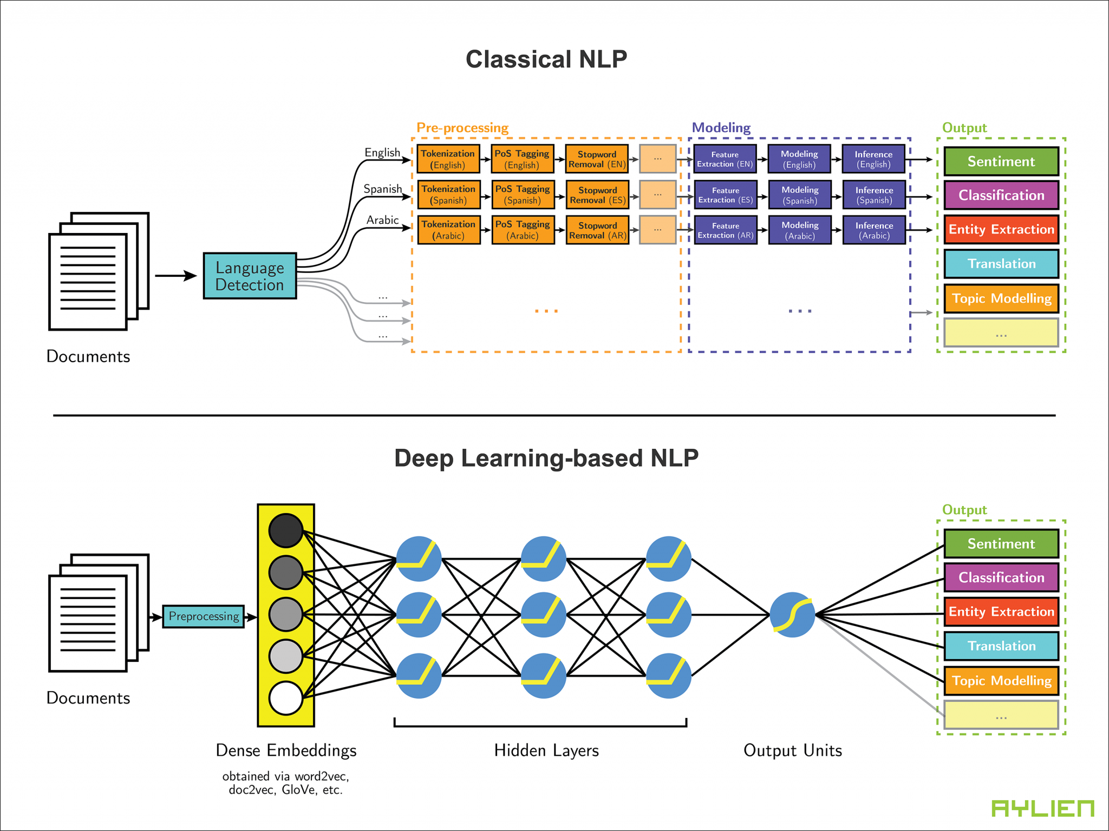
How Does it work ?
Notes:
https://en.wikipedia.org/wiki/Text_mining
1.The first step in text analytics is identifying what language the text is written in. Spanish? Einglish? Arabic? Each language has its own idiosyncrasies, so it’s important to know what we’re dealing with.
2. Most text analytics systems rely on rules-based algorithms to tokenize alphabetic languages, but logographic languages ( like chineese / japaneese) require the use of complex machine learning algorithms. Now that we know what language the text is in, we can break it up into pieces. Tokens are the individual units of meaning you’re operating on. This can can be words, phonemes, or even full sentences. Tokenization is the process of breaking down text document apart into those pieces. Tokenization is language-specific, and each language has its own tokenization requirements. English, for example, uses white space and punctuation to denote tokens, and is relatively simple to tokenize.
3. After we have identified the tokens we can tell where the sentences end. Sometimes its not obvious to tell where the boundaries are on a sentence. Think twitter and other logographic languages
4. Part of Speech tagging (or PoS tagging) is the process of determining the part of speech of every token in a document, and then tagging it as such. For example, we use PoS tagging to figure out whether a given token represents a proper noun or a common noun, or if it’s a verb, an adjective, or something else entirely. PoS tagging means assigning parts of speech to tokens
5. Chunking means assigning PoS-tagged tokens to phrases
The tall man is going to quickly walk under the ladder.
PoS tagging will identify man and ladder as nouns and walk as a verb.
Chunking will return: [the tall man]_np [is going to quickly walk]_vp [under the ladder]_pp
(np stands for “noun phrase,” vp stands for “verb phrase,” and pp stands for “prepositional phrase.”)
6. syntax parsing is a way to determine the structure of a sentence.
Apple was doing poorly until Steve Jobs…
Because Apple was doing poorly, Steve Jobs…
Apple was doing poorly because Steve Jobs…
In the first sentence, Apple is negative, whereas Steve Jobs is positive.
In the second, Apple is still negative, but Steve Jobs is now neutral.
In the final example, both Apple and Steve Jobs are negative.
most computationally-intensive steps in text analytics. Needed for sentiment analysis
7. Connecting related sentences. Links individual sentences by each sentence’s strength of association to an overall topic. Even if sentences appear many paragraphs apart in a document, the sentence chain will flow through the document and help a machine detect over-arching topics and quantify the overall “feel”.You can use this for comparing and contrasting sentiment scores and quickly generating accurate summaries of long documents.

Slide 9
SPSS – Modeler Premium
Natural Language Processor - Workflow - Details
Input text
(Corpus)
File Pre-processing
Text Pre-processing
Forcing + Extraction
Exclusion
Typing
Grouping
Indexing
Extracted concepts
TLA patterns
Categories
9
9

Slide 10
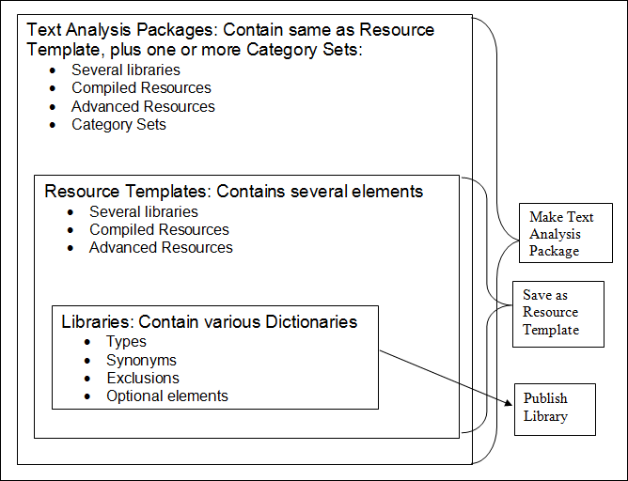
Linguistic Resource Relationships
10
10

Slide 11
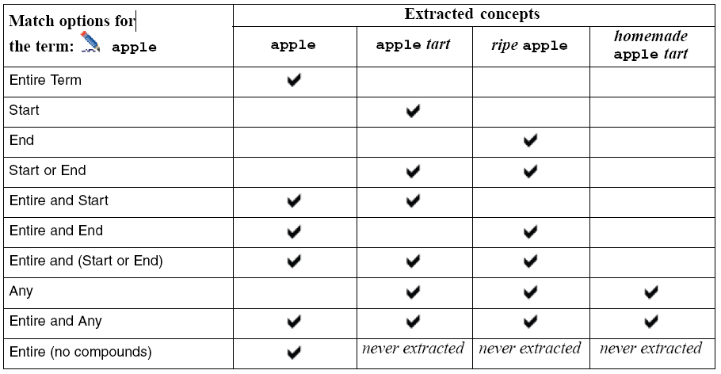
Mastering Match Options
11
11

Slide 12
About Category Descriptors…
Descriptors can be:
Concepts
Types
TLA Concept Patterns
TLA Type Patterns
Business Rules
Notes:
Note to trainer: just to have a reminder on what a descriptor can be and what are the visual clues available.
Emphasize each time that concept is preceded by blue pencil, business rule start with fx…
Fx dealer | dealership: business rule obtained by concept derivation
Fx service & excellent: business rule made of concept service, operator AND (&) and concept excellent.
Fx service & !(friendly): business rule made of concept service, operator NOT (&()) and concept friendly.
Fx [* service * & !(<PositiveAttitude>)]: business rule made of a TLA pattern where any slot contains concept service and any slot is NOT type <PositiveAttitude>.

Slide 13
Steven D. Reeves
Certified Cloud Pak Engineer
Data Scientist – (NLP) Text Analytics Specialist
Distribution Market
sdreeves@us.ibm.com
SPSS Modeler Text Analytics
Let’s simplify your information architecture
and put your data to work
Forrester Wave Leader
Enterprise Insights Platform, 2020
THANK YOU!!!
Notes:
We need to create the envelopes that make us look like a $500M company. Let everyone else tuck into that envelope, we can create a whole that is greater than the sum of its parts.- Wally

Slide 14
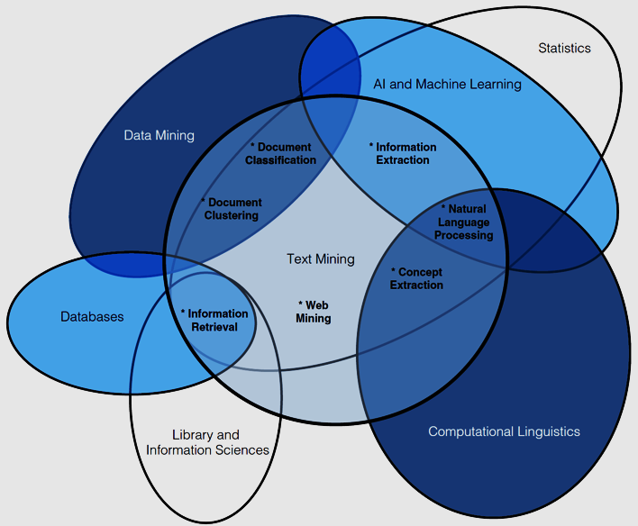
What is Text Analytics
Introduction to Text Analytics
TA synonymous to Text Mining – Almost a century old
Understand the text itself, identify or categorize the author(s), or connect the text to something tangible in the world, or an event.
Can include computational linguistics, content analysis, information retrieval, and natural language processing
The process of extracting meaning out of text
90% of all the data created was in the last 24 months
(Avg 2.5 quintillion bytes/day)
90% of that is unstructured, texts, tweets, pictures, and videos
(Griffith, 2018).
Notes:
Industry Stats - 90% of all the data in the world created in the last 24 months — avg 2.5 quintillion bytes/day — 90% of that is unstructured, texts, tweets, pictures, and videos (Griffith, 2018).
Discovering meaning & purpose of this unstructured data = rise of text analytics
Text Analytics synonymous to Text Mining – Almost a century old
Understand the text itself, identify or categorize the author(s), or connect the text to something tangible in the world, or an event.
TA can include computational linguistics, content analysis, information retrieval, and natural language processing
A discipline of computer science that combines machine learning and natural language processing (NLP) to draw meaning from unstructured text documents.

Slide 15
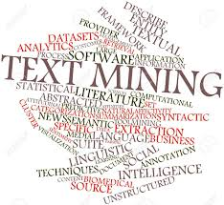
Natural Language Processing: NLP is considered the hierarchical term for the range of natural language technologies, NLP is leveraged within almost every text analytics solution. It’s the cognitive computing component focused on linguistics and language’s classification. NLP is really for the semantic structure of the language… What are the nouns, what are the verbs, what is the vocabulary, how does the sentence structure fit together with the adverbs and pronouns? What are the different stems?”
Text Analytics
Natural Language Understanding: NLU is largely regarded as a subset of NLP, focused on the actual meaning of words, which might be at odds with how they’re semantically structured. It provides an understanding of how terms are used in context for situations involving sarcasm, irony, sentiment, humor, colloquialisms, and others. In most text analytics platforms relying on NLP, usually, NLU is a part of it because most business are looking for sentiment and contextual analysis, and contextual extractions, together.
Natural Language Generation: NLG is the converse of NLP in that it’s not an analysis of the semantic meaning of language, but the production or generation of it (usually in either text or speech).
How Does it work ?
Natural Language Interaction: NLI is somewhat a conflation of these technologies—although it doesn’t have to involve NLU— in which users communicate and evoke responses from systems via natural language. It is the ability to give a command by either typing it or speaking it. That’s the interaction piece. Then it’s able to actually generate a response. It is either an automated voice back or a typed response.
Notes:
https://en.wikipedia.org/wiki/Text_mining
1.The first step in text analytics is identifying what language the text is written in. Spanish? Einglish? Arabic? Each language has its own idiosyncrasies, so it’s important to know what we’re dealing with.
2. Most text analytics systems rely on rules-based algorithms to tokenize alphabetic languages, but logographic languages ( like chineese / japaneese) require the use of complex machine learning algorithms. Now that we know what language the text is in, we can break it up into pieces. Tokens are the individual units of meaning you’re operating on. This can can be words, phonemes, or even full sentences. Tokenization is the process of breaking down text document apart into those pieces. Tokenization is language-specific, and each language has its own tokenization requirements. English, for example, uses white space and punctuation to denote tokens, and is relatively simple to tokenize.
3. After we have identified the tokens we can tell where the sentences end. Sometimes its not obvious to tell where the boundaries are on a sentence. Think twitter and other logographic languages
4. Part of Speech tagging (or PoS tagging) is the process of determining the part of speech of every token in a document, and then tagging it as such. For example, we use PoS tagging to figure out whether a given token represents a proper noun or a common noun, or if it’s a verb, an adjective, or something else entirely. PoS tagging means assigning parts of speech to tokens
5. Chunking means assigning PoS-tagged tokens to phrases
The tall man is going to quickly walk under the ladder.
PoS tagging will identify man and ladder as nouns and walk as a verb.
Chunking will return: [the tall man]_np [is going to quickly walk]_vp [under the ladder]_pp
(np stands for “noun phrase,” vp stands for “verb phrase,” and pp stands for “prepositional phrase.”)
6. syntax parsing is a way to determine the structure of a sentence.
Apple was doing poorly until Steve Jobs…
Because Apple was doing poorly, Steve Jobs…
Apple was doing poorly because Steve Jobs…
In the first sentence, Apple is negative, whereas Steve Jobs is positive.
In the second, Apple is still negative, but Steve Jobs is now neutral.
In the final example, both Apple and Steve Jobs are negative.
most computationally-intensive steps in text analytics. Needed for sentiment analysis
7. Connecting related sentences. Links individual sentences by each sentence’s strength of association to an overall topic. Even if sentences appear many paragraphs apart in a document, the sentence chain will flow through the document and help a machine detect over-arching topics and quantify the overall “feel”.You can use this for comparing and contrasting sentiment scores and quickly generating accurate summaries of long documents.

Slide 16
Computational Linguistics: is an interdisciplinary field concerned with the statistical or rule- based modeling of natural language from a computational (computer) perspective, as well as the study of appropriate computational approaches to linguistic questions.
Text Analytics
How Does it work ?
Notes:
https://en.wikipedia.org/wiki/Text_mining
1.The first step in text analytics is identifying what language the text is written in. Spanish? Einglish? Arabic? Each language has its own idiosyncrasies, so it’s important to know what we’re dealing with.
2. Most text analytics systems rely on rules-based algorithms to tokenize alphabetic languages, but logographic languages ( like chineese / japaneese) require the use of complex machine learning algorithms. Now that we know what language the text is in, we can break it up into pieces. Tokens are the individual units of meaning you’re operating on. This can can be words, phonemes, or even full sentences. Tokenization is the process of breaking down text document apart into those pieces. Tokenization is language-specific, and each language has its own tokenization requirements. English, for example, uses white space and punctuation to denote tokens, and is relatively simple to tokenize.
3. After we have identified the tokens we can tell where the sentences end. Sometimes its not obvious to tell where the boundaries are on a sentence. Think twitter and other logographic languages
4. Part of Speech tagging (or PoS tagging) is the process of determining the part of speech of every token in a document, and then tagging it as such. For example, we use PoS tagging to figure out whether a given token represents a proper noun or a common noun, or if it’s a verb, an adjective, or something else entirely. PoS tagging means assigning parts of speech to tokens
5. Chunking means assigning PoS-tagged tokens to phrases
The tall man is going to quickly walk under the ladder.
PoS tagging will identify man and ladder as nouns and walk as a verb.
Chunking will return: [the tall man]_np [is going to quickly walk]_vp [under the ladder]_pp
(np stands for “noun phrase,” vp stands for “verb phrase,” and pp stands for “prepositional phrase.”)
6. syntax parsing is a way to determine the structure of a sentence.
Apple was doing poorly until Steve Jobs…
Because Apple was doing poorly, Steve Jobs…
Apple was doing poorly because Steve Jobs…
In the first sentence, Apple is negative, whereas Steve Jobs is positive.
In the second, Apple is still negative, but Steve Jobs is now neutral.
In the final example, both Apple and Steve Jobs are negative.
most computationally-intensive steps in text analytics. Needed for sentiment analysis
7. Connecting related sentences. Links individual sentences by each sentence’s strength of association to an overall topic. Even if sentences appear many paragraphs apart in a document, the sentence chain will flow through the document and help a machine detect over-arching topics and quantify the overall “feel”.You can use this for comparing and contrasting sentiment scores and quickly generating accurate summaries of long documents.

Slide 17
How Does it work ?
Notes:
https://en.wikipedia.org/wiki/Text_mining
1.The first step in text analytics is identifying what language the text is written in. Spanish? Einglish? Arabic? Each language has its own idiosyncrasies, so it’s important to know what we’re dealing with.
2. Most text analytics systems rely on rules-based algorithms to tokenize alphabetic languages, but logographic languages ( like chineese / japaneese) require the use of complex machine learning algorithms. Now that we know what language the text is in, we can break it up into pieces. Tokens are the individual units of meaning you’re operating on. This can can be words, phonemes, or even full sentences. Tokenization is the process of breaking down text document apart into those pieces. Tokenization is language-specific, and each language has its own tokenization requirements. English, for example, uses white space and punctuation to denote tokens, and is relatively simple to tokenize.
3. After we have identified the tokens we can tell where the sentences end. Sometimes its not obvious to tell where the boundaries are on a sentence. Think twitter and other logographic languages
4. Part of Speech tagging (or PoS tagging) is the process of determining the part of speech of every token in a document, and then tagging it as such. For example, we use PoS tagging to figure out whether a given token represents a proper noun or a common noun, or if it’s a verb, an adjective, or something else entirely. PoS tagging means assigning parts of speech to tokens
5. Chunking means assigning PoS-tagged tokens to phrases
The tall man is going to quickly walk under the ladder.
PoS tagging will identify man and ladder as nouns and walk as a verb.
Chunking will return: [the tall man]_np [is going to quickly walk]_vp [under the ladder]_pp
(np stands for “noun phrase,” vp stands for “verb phrase,” and pp stands for “prepositional phrase.”)
6. syntax parsing is a way to determine the structure of a sentence.
Apple was doing poorly until Steve Jobs…
Because Apple was doing poorly, Steve Jobs…
Apple was doing poorly because Steve Jobs…
In the first sentence, Apple is negative, whereas Steve Jobs is positive.
In the second, Apple is still negative, but Steve Jobs is now neutral.
In the final example, both Apple and Steve Jobs are negative.
most computationally-intensive steps in text analytics. Needed for sentiment analysis
7. Connecting related sentences. Links individual sentences by each sentence’s strength of association to an overall topic. Even if sentences appear many paragraphs apart in a document, the sentence chain will flow through the document and help a machine detect over-arching topics and quantify the overall “feel”.You can use this for comparing and contrasting sentiment scores and quickly generating accurate summaries of long documents.

Slide 18

Introduction to Text Analytics
How Does it work ?
Common Steps involved in preparing an unstructured text document for analysis:
Language Identification
Tokenization
Sentence Breaking
Part of Speech (POS) Tagging
Chunking / Light Parsing
Syntax Parsing / Sentence diagramming
Sentence Chaining / Sentence relation
Notes:
https://en.wikipedia.org/wiki/Text_mining
1.The first step in text analytics is identifying what language the text is written in. Spanish? Einglish? Arabic? Each language has its own idiosyncrasies, so it’s important to know what we’re dealing with.
2. Most text analytics systems rely on rules-based algorithms to tokenize alphabetic languages, but logographic languages ( like chineese / japaneese) require the use of complex machine learning algorithms. Now that we know what language the text is in, we can break it up into pieces. Tokens are the individual units of meaning you’re operating on. This can can be words, phonemes, or even full sentences. Tokenization is the process of breaking down text document apart into those pieces. Tokenization is language-specific, and each language has its own tokenization requirements. English, for example, uses white space and punctuation to denote tokens, and is relatively simple to tokenize.
3. After we have identified the tokens we can tell where the sentences end. Sometimes its not obvious to tell where the boundaries are on a sentence. Think twitter and other logographic languages
4. Part of Speech tagging (or PoS tagging) is the process of determining the part of speech of every token in a document, and then tagging it as such. For example, we use PoS tagging to figure out whether a given token represents a proper noun or a common noun, or if it’s a verb, an adjective, or something else entirely. PoS tagging means assigning parts of speech to tokens
5. Chunking means assigning PoS-tagged tokens to phrases
The tall man is going to quickly walk under the ladder.
PoS tagging will identify man and ladder as nouns and walk as a verb.
Chunking will return: [the tall man]_np [is going to quickly walk]_vp [under the ladder]_pp
(np stands for “noun phrase,” vp stands for “verb phrase,” and pp stands for “prepositional phrase.”)
6. syntax parsing is a way to determine the structure of a sentence.
Apple was doing poorly until Steve Jobs…
Because Apple was doing poorly, Steve Jobs…
Apple was doing poorly because Steve Jobs…
In the first sentence, Apple is negative, whereas Steve Jobs is positive.
In the second, Apple is still negative, but Steve Jobs is now neutral.
In the final example, both Apple and Steve Jobs are negative.
most computationally-intensive steps in text analytics. Needed for sentiment analysis
7. Connecting related sentences. Links individual sentences by each sentence’s strength of association to an overall topic. Even if sentences appear many paragraphs apart in a document, the sentence chain will flow through the document and help a machine detect over-arching topics and quantify the overall “feel”.You can use this for comparing and contrasting sentiment scores and quickly generating accurate summaries of long documents.

Slide 19
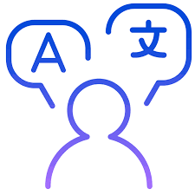
Introduction to Text Analytics
How Does it work ?
Language Identification. -
Different techniques such as using a n-gram algorithm to detect language.
Use ML for character recognition in case of logographic language like Chinese.
I like the red apple pie. English
J’aime la tarte aux pommes rouges. French
Tokenization
Breaking down the text into it’s smallest atomic units.
Easy for alphabetic languages . Character based languages may require more work.
Punctuation is also a token!
<I> <like> <the> <red> <apple> <pie> <.>
7 tokens…
Notes:
https://en.wikipedia.org/wiki/Text_mining
1.The first step in text analytics is identifying what language the text is written in. Spanish? Einglish? Arabic? Each language has its own idiosyncrasies, so it’s important to know what we’re dealing with.
2. Most text analytics systems rely on rules-based algorithms to tokenize alphabetic languages, but logographic languages ( like chineese / japaneese) require the use of complex machine learning algorithms. Now that we know what language the text is in, we can break it up into pieces. Tokens are the individual units of meaning you’re operating on. This can can be words, phonemes, or even full sentences. Tokenization is the process of breaking down text document apart into those pieces. Tokenization is language-specific, and each language has its own tokenization requirements. English, for example, uses white space and punctuation to denote tokens, and is relatively simple to tokenize.
3. After we have identified the tokens we can tell where the sentences end. Sometimes its not obvious to tell where the boundaries are on a sentence. Think twitter and other logographic languages
4. Part of Speech tagging (or PoS tagging) is the process of determining the part of speech of every token in a document, and then tagging it as such. For example, we use PoS tagging to figure out whether a given token represents a proper noun or a common noun, or if it’s a verb, an adjective, or something else entirely. PoS tagging means assigning parts of speech to tokens
5. Chunking means assigning PoS-tagged tokens to phrases
The tall man is going to quickly walk under the ladder.
PoS tagging will identify man and ladder as nouns and walk as a verb.
Chunking will return: [the tall man]_np [is going to quickly walk]_vp [under the ladder]_pp
(np stands for “noun phrase,” vp stands for “verb phrase,” and pp stands for “prepositional phrase.”)
6. syntax parsing is a way to determine the structure of a sentence.
Apple was doing poorly until Steve Jobs…
Because Apple was doing poorly, Steve Jobs…
Apple was doing poorly because Steve Jobs…
In the first sentence, Apple is negative, whereas Steve Jobs is positive.
In the second, Apple is still negative, but Steve Jobs is now neutral.
In the final example, both Apple and Steve Jobs are negative.
most computationally-intensive steps in text analytics. Needed for sentiment analysis
7. Connecting related sentences. Links individual sentences by each sentence’s strength of association to an overall topic. Even if sentences appear many paragraphs apart in a document, the sentence chain will flow through the document and help a machine detect over-arching topics and quantify the overall “feel”.You can use this for comparing and contrasting sentiment scores and quickly generating accurate summaries of long documents.

Slide 20
Introduction to Text Analytics
How Does it work ?
Sentence Breaking.
Where does a sentence end. What are the boundaries ?
Sentence breaking is particularly important for providing context about what is happening.
<I love the red apple pie!>
Part of Speech (PoS) Tagging
Tagging the tokens to represent PoS. Noun, Pronoun, Verbs, Adjectives, etc.
Stopword List
Noun = apple and pie Verb = love
Stopword = the
<I> <love> <the> <red> <apple> <pie><!>
verb
adjective
punctuation
pronoun
determiner
noun
noun
Notes:
https://en.wikipedia.org/wiki/Text_mining
1.The first step in text analytics is identifying what language the text is written in. Spanish? Einglish? Arabic? Each language has its own idiosyncrasies, so it’s important to know what we’re dealing with.
2. Most text analytics systems rely on rules-based algorithms to tokenize alphabetic languages, but logographic languages ( like chineese / japaneese) require the use of complex machine learning algorithms. Now that we know what language the text is in, we can break it up into pieces. Tokens are the individual units of meaning you’re operating on. This can can be words, phonemes, or even full sentences. Tokenization is the process of breaking down text document apart into those pieces. Tokenization is language-specific, and each language has its own tokenization requirements. English, for example, uses white space and punctuation to denote tokens, and is relatively simple to tokenize.
3. After we have identified the tokens we can tell where the sentences end. Sometimes its not obvious to tell where the boundaries are on a sentence. Think twitter and other logographic languages
4. Part of Speech tagging (or PoS tagging) is the process of determining the part of speech of every token in a document, and then tagging it as such. For example, we use PoS tagging to figure out whether a given token represents a proper noun or a common noun, or if it’s a verb, an adjective, or something else entirely. PoS tagging means assigning parts of speech to tokens
5. Chunking means assigning PoS-tagged tokens to phrases
The tall man is going to quickly walk under the ladder.
PoS tagging will identify man and ladder as nouns and walk as a verb.
Chunking will return: [the tall man]_np [is going to quickly walk]_vp [under the ladder]_pp
(np stands for “noun phrase,” vp stands for “verb phrase,” and pp stands for “prepositional phrase.”)
6. syntax parsing is a way to determine the structure of a sentence.
Apple was doing poorly until Steve Jobs…
Because Apple was doing poorly, Steve Jobs…
Apple was doing poorly because Steve Jobs…
In the first sentence, Apple is negative, whereas Steve Jobs is positive.
In the second, Apple is still negative, but Steve Jobs is now neutral.
In the final example, both Apple and Steve Jobs are negative.
most computationally-intensive steps in text analytics. Needed for sentiment analysis
7. Connecting related sentences. Links individual sentences by each sentence’s strength of association to an overall topic. Even if sentences appear many paragraphs apart in a document, the sentence chain will flow through the document and help a machine detect over-arching topics and quantify the overall “feel”.You can use this for comparing and contrasting sentiment scores and quickly generating accurate summaries of long documents.

Slide 21
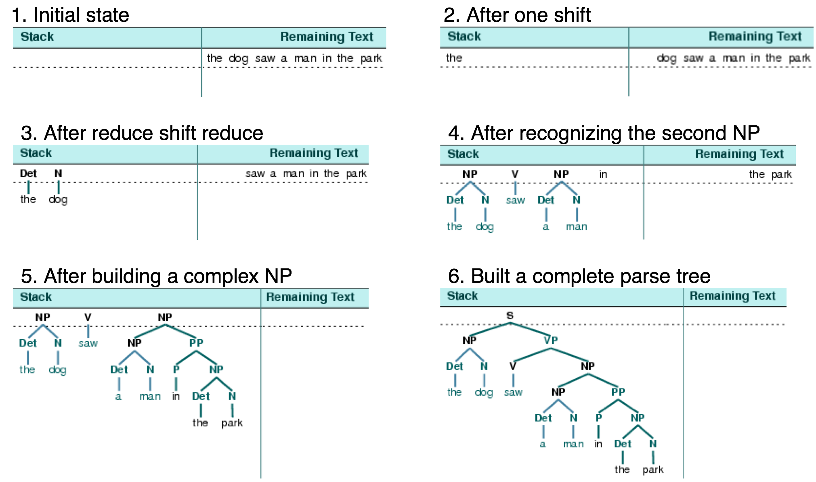
Syntax Parsing / Sentence diagramming
Grammatical arrangement of words in a sentence and their relationship with each other.
Introduction to Text Analytics
How Does it work ?
Chunking/Light/Shallow Parsing
Identifies constituent parts of sentences and then links them to higher order units
(np =“noun phrase,” vp =“verb phrase,” pp stands = “prepositional phrase.”)
NP
VP
PP
The red bird flies quickly over the ladder.
Notes:
Guide to sentence diagramming
http://grammar.ccc.commnet.edu/grammar/diagrams2/one_pager1.htm
Diagram source : https://www.conceptdraw.com/examples/example-of-diagramming-sentences
https://en.wikipedia.org/wiki/Text_mining
1.The first step in text analytics is identifying what language the text is written in. Spanish? Einglish? Arabic? Each language has its own idiosyncrasies, so it’s important to know what we’re dealing with.
2. Most text analytics systems rely on rules-based algorithms to tokenize alphabetic languages, but logographic languages ( like chineese / japaneese) require the use of complex machine learning algorithms. Now that we know what language the text is in, we can break it up into pieces. Tokens are the individual units of meaning you’re operating on. This can can be words, phonemes, or even full sentences. Tokenization is the process of breaking down text document apart into those pieces. Tokenization is language-specific, and each language has its own tokenization requirements. English, for example, uses white space and punctuation to denote tokens, and is relatively simple to tokenize.
3. After we have identified the tokens we can tell where the sentences end. Sometimes its not obvious to tell where the boundaries are on a sentence. Think twitter and other logographic languages
4. Part of Speech tagging (or PoS tagging) is the process of determining the part of speech of every token in a document, and then tagging it as such. For example, we use PoS tagging to figure out whether a given token represents a proper noun or a common noun, or if it’s a verb, an adjective, or something else entirely. PoS tagging means assigning parts of speech to tokens
5. Chunking means assigning PoS-tagged tokens to phrases
The tall man is going to quickly walk under the ladder.
PoS tagging will identify man and ladder as nouns and walk as a verb.
Chunking will return: [the tall man]_np [is going to quickly walk]_vp [under the ladder]_pp
(np stands for “noun phrase,” vp stands for “verb phrase,” and pp stands for “prepositional phrase.”)
6. syntax parsing is a way to determine the structure of a sentence.
Apple was doing poorly until Steve Jobs…
Because Apple was doing poorly, Steve Jobs…
Apple was doing poorly because Steve Jobs…
In the first sentence, Apple is negative, whereas Steve Jobs is positive.
In the second, Apple is still negative, but Steve Jobs is now neutral.
In the final example, both Apple and Steve Jobs are negative.
most computationally-intensive steps in text analytics. Needed for sentiment analysis
7. Connecting related sentences. Links individual sentences by each sentence’s strength of association to an overall topic. Even if sentences appear many paragraphs apart in a document, the sentence chain will flow through the document and help a machine detect over-arching topics and quantify the overall “feel”.You can use this for comparing and contrasting sentiment scores and quickly generating accurate summaries of long documents.

Slide 22
Introduction to Text Analytics
How Does it work ?
The orange leaves slowly fell onto the ground.
Notes:
https://www.english-grammar-revolution.com/sentence-diagrams.html

Slide 23
Introduction to Text Analytics
How Does it work ?
Sentence Chaining / Sentence relation
Drawing association between multiple sentences in a document
Useful for identifying the overall “feel” of the document
Summaries of long docs
Notes:
https://en.wikipedia.org/wiki/Text_mining
1.The first step in text analytics is identifying what language the text is written in. Spanish? Einglish? Arabic? Each language has its own idiosyncrasies, so it’s important to know what we’re dealing with.
2. Most text analytics systems rely on rules-based algorithms to tokenize alphabetic languages, but logographic languages ( like chineese / japaneese) require the use of complex machine learning algorithms. Now that we know what language the text is in, we can break it up into pieces. Tokens are the individual units of meaning you’re operating on. This can can be words, phonemes, or even full sentences. Tokenization is the process of breaking down text document apart into those pieces. Tokenization is language-specific, and each language has its own tokenization requirements. English, for example, uses white space and punctuation to denote tokens, and is relatively simple to tokenize.
3. After we have identified the tokens we can tell where the sentences end. Sometimes its not obvious to tell where the boundaries are on a sentence. Think twitter and other logographic languages
4. Part of Speech tagging (or PoS tagging) is the process of determining the part of speech of every token in a document, and then tagging it as such. For example, we use PoS tagging to figure out whether a given token represents a proper noun or a common noun, or if it’s a verb, an adjective, or something else entirely. PoS tagging means assigning parts of speech to tokens
5. Chunking means assigning PoS-tagged tokens to phrases
The tall man is going to quickly walk under the ladder.
PoS tagging will identify man and ladder as nouns and walk as a verb.
Chunking will return: [the tall man]_np [is going to quickly walk]_vp [under the ladder]_pp
(np stands for “noun phrase,” vp stands for “verb phrase,” and pp stands for “prepositional phrase.”)
6. syntax parsing is a way to determine the structure of a sentence.
Apple was doing poorly until Steve Jobs…
Because Apple was doing poorly, Steve Jobs…
Apple was doing poorly because Steve Jobs…
In the first sentence, Apple is negative, whereas Steve Jobs is positive.
In the second, Apple is still negative, but Steve Jobs is now neutral.
In the final example, both Apple and Steve Jobs are negative.
most computationally-intensive steps in text analytics. Needed for sentiment analysis
7. Connecting related sentences. Links individual sentences by each sentence’s strength of association to an overall topic. Even if sentences appear many paragraphs apart in a document, the sentence chain will flow through the document and help a machine detect over-arching topics and quantify the overall “feel”.You can use this for comparing and contrasting sentiment scores and quickly generating accurate summaries of long documents.

Slide 24
How Does it work ?
Notes:
https://en.wikipedia.org/wiki/Text_mining
1.The first step in text analytics is identifying what language the text is written in. Spanish? Einglish? Arabic? Each language has its own idiosyncrasies, so it’s important to know what we’re dealing with.
2. Most text analytics systems rely on rules-based algorithms to tokenize alphabetic languages, but logographic languages ( like chineese / japaneese) require the use of complex machine learning algorithms. Now that we know what language the text is in, we can break it up into pieces. Tokens are the individual units of meaning you’re operating on. This can can be words, phonemes, or even full sentences. Tokenization is the process of breaking down text document apart into those pieces. Tokenization is language-specific, and each language has its own tokenization requirements. English, for example, uses white space and punctuation to denote tokens, and is relatively simple to tokenize.
3. After we have identified the tokens we can tell where the sentences end. Sometimes its not obvious to tell where the boundaries are on a sentence. Think twitter and other logographic languages
4. Part of Speech tagging (or PoS tagging) is the process of determining the part of speech of every token in a document, and then tagging it as such. For example, we use PoS tagging to figure out whether a given token represents a proper noun or a common noun, or if it’s a verb, an adjective, or something else entirely. PoS tagging means assigning parts of speech to tokens
5. Chunking means assigning PoS-tagged tokens to phrases
The tall man is going to quickly walk under the ladder.
PoS tagging will identify man and ladder as nouns and walk as a verb.
Chunking will return: [the tall man]_np [is going to quickly walk]_vp [under the ladder]_pp
(np stands for “noun phrase,” vp stands for “verb phrase,” and pp stands for “prepositional phrase.”)
6. syntax parsing is a way to determine the structure of a sentence.
Apple was doing poorly until Steve Jobs…
Because Apple was doing poorly, Steve Jobs…
Apple was doing poorly because Steve Jobs…
In the first sentence, Apple is negative, whereas Steve Jobs is positive.
In the second, Apple is still negative, but Steve Jobs is now neutral.
In the final example, both Apple and Steve Jobs are negative.
most computationally-intensive steps in text analytics. Needed for sentiment analysis
7. Connecting related sentences. Links individual sentences by each sentence’s strength of association to an overall topic. Even if sentences appear many paragraphs apart in a document, the sentence chain will flow through the document and help a machine detect over-arching topics and quantify the overall “feel”.You can use this for comparing and contrasting sentiment scores and quickly generating accurate summaries of long documents.

Slide 25
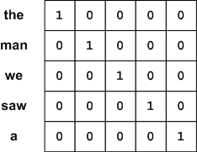
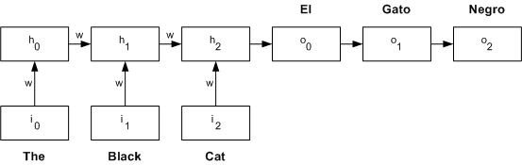
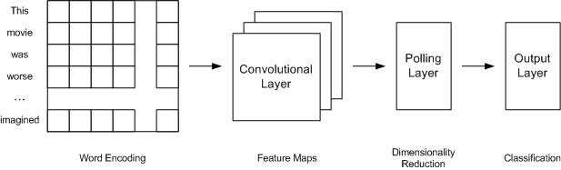
Word Encodings
How Does it work ?
Recurrent Neural Networks
Deep Learning
Notes:
https://en.wikipedia.org/wiki/Text_mining
1.The first step in text analytics is identifying what language the text is written in. Spanish? Einglish? Arabic? Each language has its own idiosyncrasies, so it’s important to know what we’re dealing with.
2. Most text analytics systems rely on rules-based algorithms to tokenize alphabetic languages, but logographic languages ( like chineese / japaneese) require the use of complex machine learning algorithms. Now that we know what language the text is in, we can break it up into pieces. Tokens are the individual units of meaning you’re operating on. This can can be words, phonemes, or even full sentences. Tokenization is the process of breaking down text document apart into those pieces. Tokenization is language-specific, and each language has its own tokenization requirements. English, for example, uses white space and punctuation to denote tokens, and is relatively simple to tokenize.
3. After we have identified the tokens we can tell where the sentences end. Sometimes its not obvious to tell where the boundaries are on a sentence. Think twitter and other logographic languages
4. Part of Speech tagging (or PoS tagging) is the process of determining the part of speech of every token in a document, and then tagging it as such. For example, we use PoS tagging to figure out whether a given token represents a proper noun or a common noun, or if it’s a verb, an adjective, or something else entirely. PoS tagging means assigning parts of speech to tokens
5. Chunking means assigning PoS-tagged tokens to phrases
The tall man is going to quickly walk under the ladder.
PoS tagging will identify man and ladder as nouns and walk as a verb.
Chunking will return: [the tall man]_np [is going to quickly walk]_vp [under the ladder]_pp
(np stands for “noun phrase,” vp stands for “verb phrase,” and pp stands for “prepositional phrase.”)
6. syntax parsing is a way to determine the structure of a sentence.
Apple was doing poorly until Steve Jobs…
Because Apple was doing poorly, Steve Jobs…
Apple was doing poorly because Steve Jobs…
In the first sentence, Apple is negative, whereas Steve Jobs is positive.
In the second, Apple is still negative, but Steve Jobs is now neutral.
In the final example, both Apple and Steve Jobs are negative.
most computationally-intensive steps in text analytics. Needed for sentiment analysis
7. Connecting related sentences. Links individual sentences by each sentence’s strength of association to an overall topic. Even if sentences appear many paragraphs apart in a document, the sentence chain will flow through the document and help a machine detect over-arching topics and quantify the overall “feel”.You can use this for comparing and contrasting sentiment scores and quickly generating accurate summaries of long documents.

Slide 26
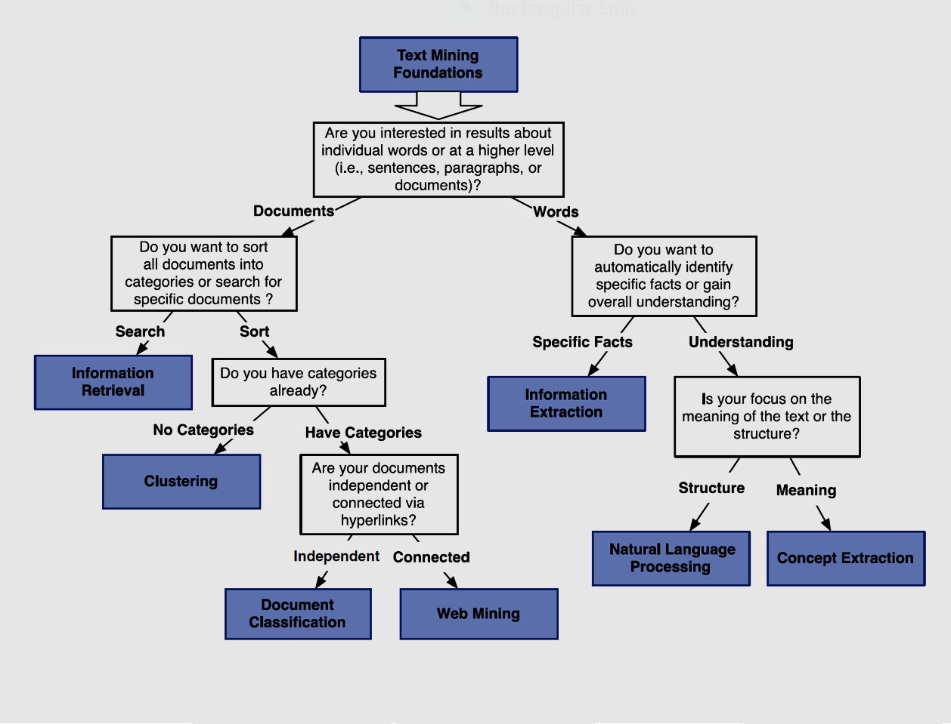
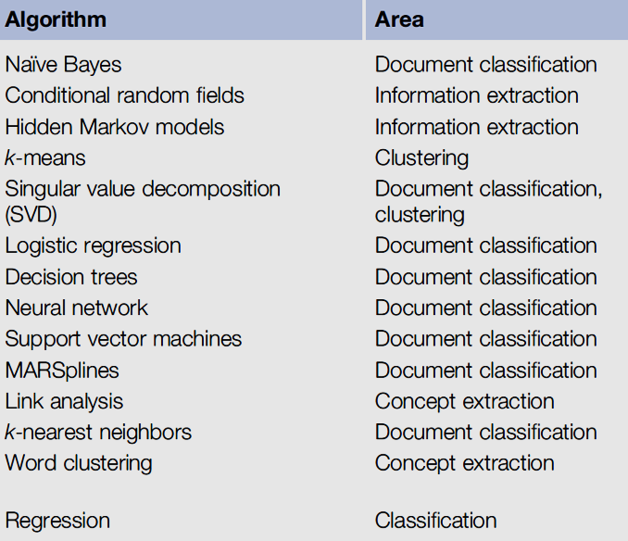
Introduction to Text Analytics
Algorithms
xx
Notes:
Which algorithms were designed for ECM C? . Compare and Discuss what Watson Discovery uses under the cover – Combination of Algorithms

Slide 27

IBM Landscape
Introduction to Text Analytics
IBM SPSS – Text Analytics
Leading visual data science and machine-learning solution. A text analytics workbench that helps build accurate predictive models quickly and intuitively, without programming
Watson Language Translator
Neural Machine Translation comes standard for each language pair. Instantly translates content into multiple languages. For translating documents, apps, and websites. 35+ Languages.
Open Source
NLTK has various capabilities
including computational linguistics, content analysis, information retrieval, and natural language processing.
Other libraries like spaCy provide NLP capabilities.
Watson Knowledge Studio
Enables developers and domain experts to collaborate on the creation of custom annotator components that can be used to identify terms, types, and relations in unstructured text. Creates rule based/machine learning models.
Watson Explorer
A cognitive exploration & content analysis platform
Watson NLU
Managed NLP service for advanced text analytics. Uses deep learning to extract metadata from text such as entities, keywords, categories, sentiment, emotion, relations, and syntax.
Watson Natural Language Classifier
Quickly and easily build custom text classification models.
Watson Discovery
Enterprise AI Cognitive Search technology that employs NLP capabilities, and can be deployed in multiple environments
* IBM also offers Speech services
Notes:
IBM Speech services not included
Nltk : pool of language processing tools including data mining, machine learning, data scraping, sentiment analysis and other various language processing tasks
https://en.wikipedia.org/wiki/List_of_text_mining_software

Slide 28


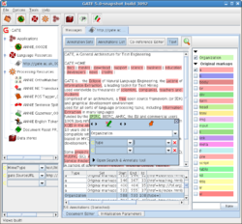

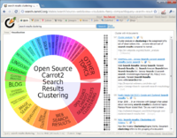
Open Source Landscape
Introduction to Text Analytics
spaCY
Python based Natural Language Processing library .
Stable release : 2.2.3 / 21 November 2019
OpenNLP
ML based toolkit for the processing of natural language text. It supports the most common NLP tasks, such as language detection, tokenization, sentence segmentation, part-of-speech tagging, named entity extraction, chunking, parsing and coreference resolution
NLTK
NLTK has various capabilities
including computational linguistics, content analysis, information retrieval, and natural language processing.
Stable release : 3.4.5 / 20 August 2019
Stable release : 1.9.1 / December 31, 2018
Orange
A data visualization, machine learning and data mining toolkit.
GATE
An open-source toolbox for natural language processing and language engineering
Carrot2
A search results clustering engine
Stable release : 8.6 June 10, 2019
Stable release : 3.23.0 / September 5, 2019
Stable release : 3.16.2 / September 20, 2019
Stable release : 3.23.0 / September 5, 2019
*This is not a exhaustive list
Notes:
Document of library updates for these packages :
Nltk : pool of language processing tools including data mining, machine learning, data scraping, sentiment analysis and other various language processing tasks
To Learn more visit this link
https://en.wikipedia.org/wiki/List_of_text_mining_software

Slide 29
IBM Text Analytics Portfolio
Introduction to Text Analytics
Features
Target Use
IBM SPSS Modeler
Text Analytics
GUI-based data science, machine learning, natural language processing algorithms.
3 Standard TA Models. (Concept, Category, & TLA)
Resources Template Editor
Visual Text Analytics Workbench
Visual data science, machine-learning, Text Analytics solution for the Enterprise
SPSS Modeler Premium, Watson Studio Desktop, Local, and Public, plus Cloud Pak for Data.
Multi - Language Support
Rich metadata extraction including text entities, concepts, keywords, categories, sentiment, emotion, relations, and syntax.
Scalability & API support
Watson NLU
Easy Integration with external apps that require meta data extraction through Natural Language Processing.
Watson Knowledge Studio
Build Domain Specific Annotators for NLU, Discovery, & WEX
No-code application, Multi - Language Support
Leverages rules + machine learning
Full data ownership + transparency
Simple to use domain specific training
Rules-based annotators
Business need for building domain-specific NLP models/annotators to analyze unstructured data.
Watson Discovery
Combines ingestion, storage, and data enrichment using Natural Language Processing to extract insights from structured and unstructured data using AI powered queries.
Scale on demand
Understands the structure of business documents.
Delivers passages as answers
Finds Patterns and Trends
ootbox line of business solution for content search and management (internal/external).
Notes:
Which product is best – Customer needs based .

Slide 30
IBM Text Analytics Portfolio
Introduction to Text Analytics
Features
Target Use
combines ingestion, storage, and data enrichment using Natural Language Processing to extract insights from structured and unstructured data using AI powered queries
Dependent on the toolkit /library used can support multiple use cases in TA .
Enterprise Content Management and Search, Business Analytics, Machine Learning, Social Media, etc.
Open Source
cognitive exploration and content analysis platform
Indexing capability
Overlap with WD
Content mining for the enterprise
Watson Explorer
Translate content text from one language to another.
Customize translations - forced glossary, parallel phrases and corpus-level customization.
35 plus languages.
Applications that require pre and post processing translation.
Watson Language Translator
Watson Natural Language Classifier
Categorize text to automate workflows, extract insights, and improve search and discovery
Update training data based on classification results
Build, Train, and Manage Classifiers via tooling or an API
Identify next best actions.
Create independent variables for machine learning models.
Organize data and documents of your corpus.
Notes:
Apache Uima
List of products available today
Feature/Functionality + Roadmap
When to position what
Check Forrester report
Include WEX
Roadmap Links and OM contacts

Slide 31
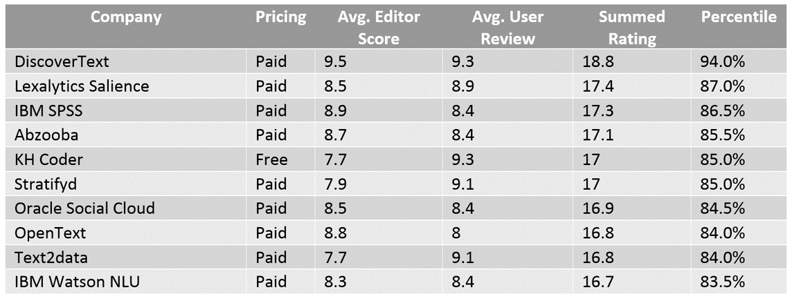
Introduction to Text Analytics
Competitive – Independent Research
83 off-the-shelf software solutions in text analytics
Top 10 text analytics software solutions ranked by aggregate critic and user review scores (Imanuel, 2019)
xx
(Miner )
Notes:
Image credit : Miner / Imanuel
More Info here
https://en.wikipedia.org/wiki/List_of_text_mining_software
https://www.predictiveanalyticstoday.com/top-software-for-text-analysis-text-mining-text-analytics/

Slide 32

Introduction to Text Analytics
Use Cases & Applications
Customer Facing
Voice of the Customer
Competitive Intelligence (CI)
Social Intelligence
Brand Management
Back Office & Other
Analytics on Internal Documents
eDiscovery - identify, collect & produce electronically stored information for legal reasons
Cognitive Search
Support generally required for frequent short text/documents , linguistic
rules , spelling correction and long complex documents (CI)
Many of our Watson Business solutions are tailored to address use cases mentioned here
Notes:
Appendix
Many of our Watson Business solutions are tailored to address usecases mentioned above
Image credit :
Areas of Interest/ Impact
Sentiment Analysis - categorizing authors by their words and behaviors to enable the development of customized marketing, persuasion, or treatment, if one can measure sentiment from text fields, then one can also measure and predict shifts in sentiment (more on this later).
Text Analytics Market Key Segments
The market for global text analytics is segmented as:
By Deployment Model
On-premise model
Cloud based model
By Application
Competitive Intelligence
Customer Relationship management
Predictive Analytics
Fraud detection
Brand Reputation
By End User
Fast Moving Consumer Goods (FMCG)
Banking Financial Services and Insurance (BFSI)
Healthcare and Pharmaceuticals
Telecommunication
Government
Retail

Slide 33
Text Analytics Labs

Slide 34
https://ibm.biz/fs20skytap

Slide 35
Please give us your feedback – Access the survey link at the bottom of the
session details in the mobile app.
Session ID: EDA23T030BH

Slide 37
Text Analytics Resources

Slide 38
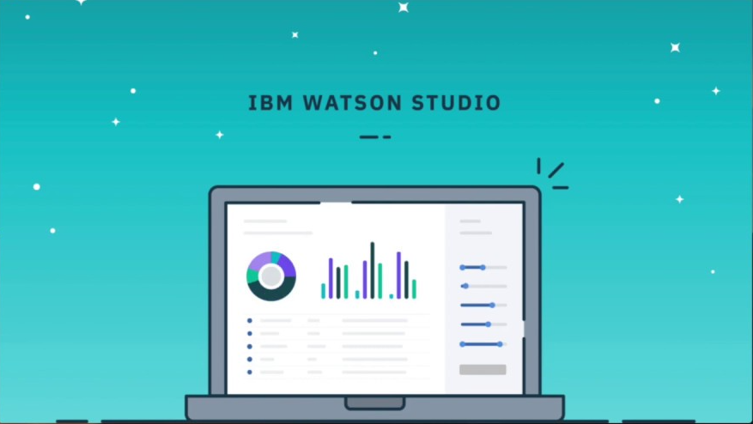
SPSS Demo/Lab (20 mins)
Lab Instructions
Download: Link TextAnalyticsFastStartEnablement2020.zip
Install Link
Notes:
Needs update

Slide 39
NLTK Demo/Lab (20 mins)
Lab Instructions
Download: Link
NLTK_Lab.zip
Install Link
Notes:
Needs update

Slide 40
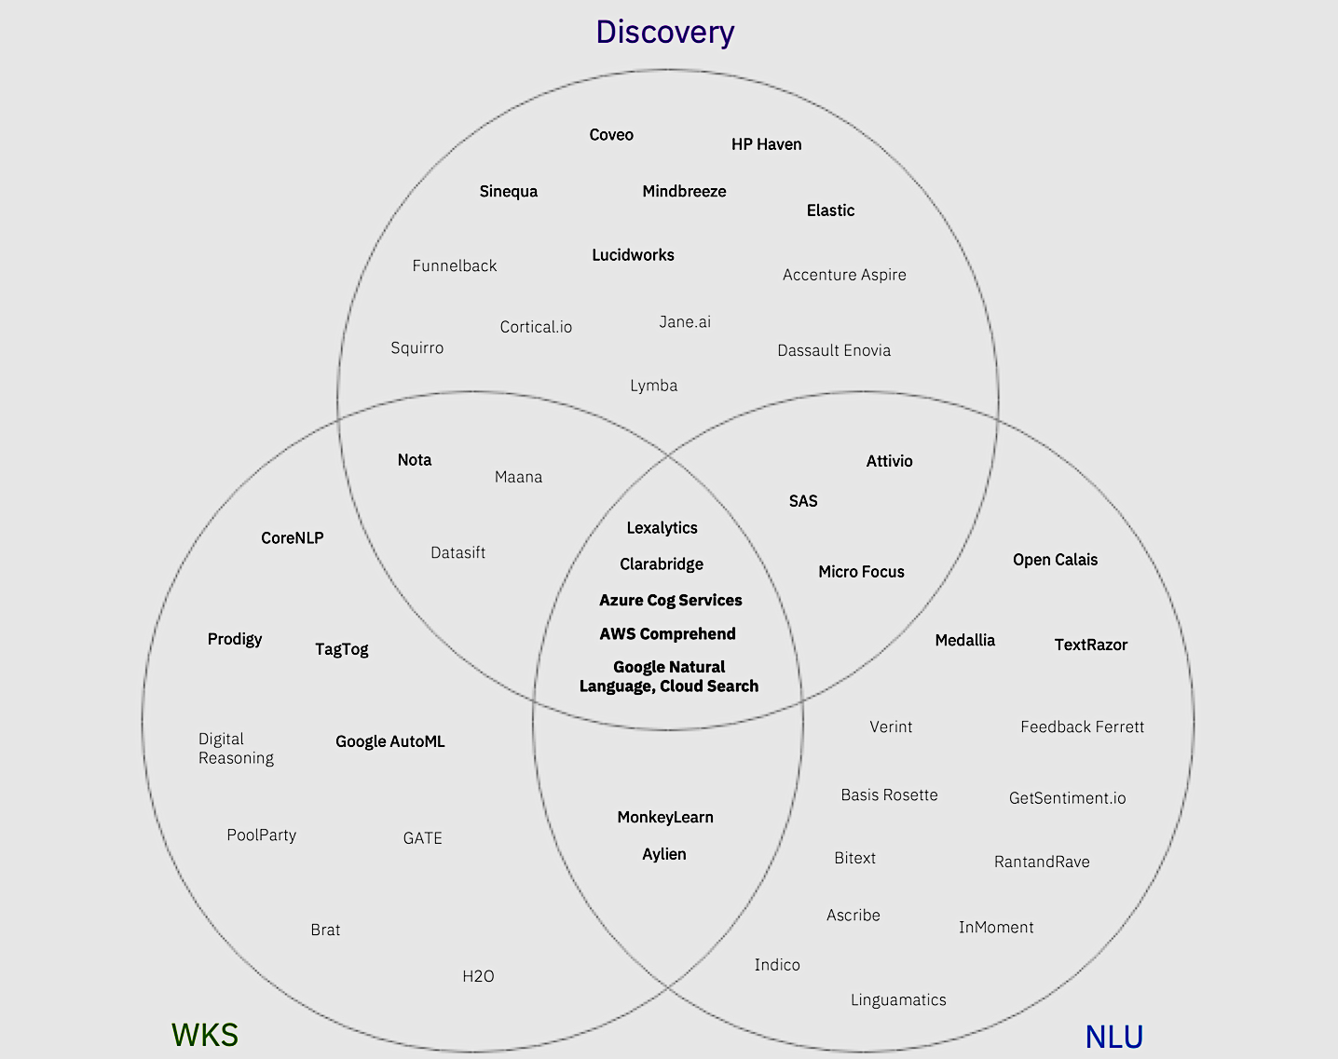
Introduction to Text Analytics
Competitive – IBM Research
Notes:
Image credit : Miner / Imanuel
More Info here
https://en.wikipedia.org/wiki/List_of_text_mining_software
https://www.predictiveanalyticstoday.com/top-software-for-text-analysis-text-mining-text-analytics/

Slide 41
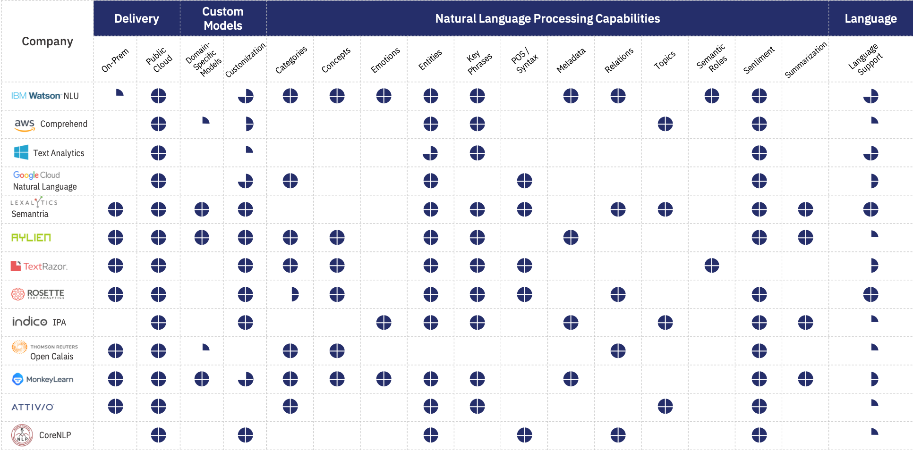
Introduction to Text Analytics
Competitive – Watson NLU
xx
Notes:
Image credit :

Slide 42
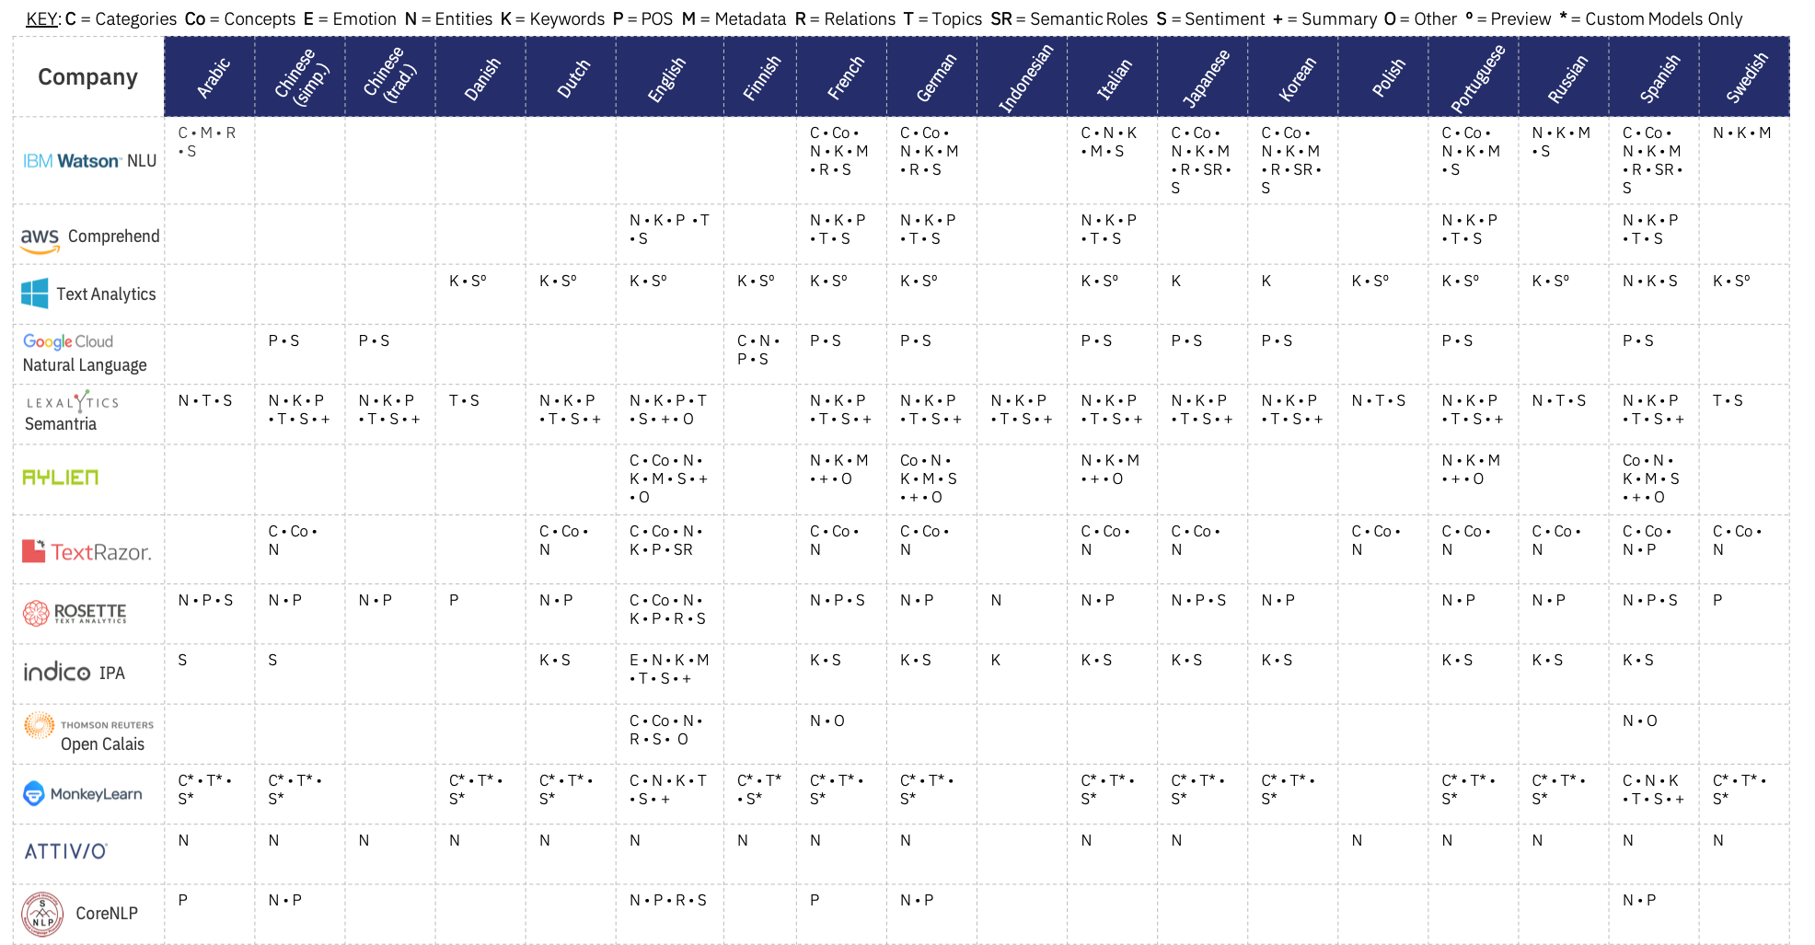
Introduction to Text Analytics
Competitive – Watson NLU
Notes:
Image credit :
In language processing vs Machine Translation

Slide 43



Introduction to Text Analytics
Competitive – Watson Knowledge Studio
Strengths | Weaknesses
Regulatory compliance No-code Rules + Machine Learning Data ownership + transparency Broad language support | ○ Unclear value prop on website ○ Lack of sharable assets (e.g. industry packs) ○ Annotation UX ○ Limited input types; no external app integration
 | Service usability | UI quality | Enrichments | Support infra | Data control + compliance
IBM Watson Knowledge Studio
Notes:
Areas of Improvement
Unclear value prop on website
○ Lack of sharable assets (e.g. industry packs)
○ Annotation UX
○ Limited input types; no external app integration

Slide 44
Introduction to Text Analytics
Competitive – Watson Knowledge Studio
 | IBM Watson Knowledge Studio | Lexalytics Semantria | Explosion Prodigy | TagTog | MonkeyLearn | NOTA | Stanford CoreNLP | Aylien Text Analysis Platform
Service Usability | 4 | 5 | 5 | 4 | 5 | 4 | 3 | 4
UI Quality | 3 | 1 | 5 | 4 | 5 | 1 | 1 | 3
Enrichments | 4 | 5 | 4 | 2 | 4 | 2 | 3 | 4
Support Infrastructure | 3 | 5 | 3 | 2 | 4 | 2 | 2 | 2
Data Control + Compliance | 5 | 2 | 2 | 1 | 3 | 2 | 1 | 1
Notes:
Image credit :

Slide 45
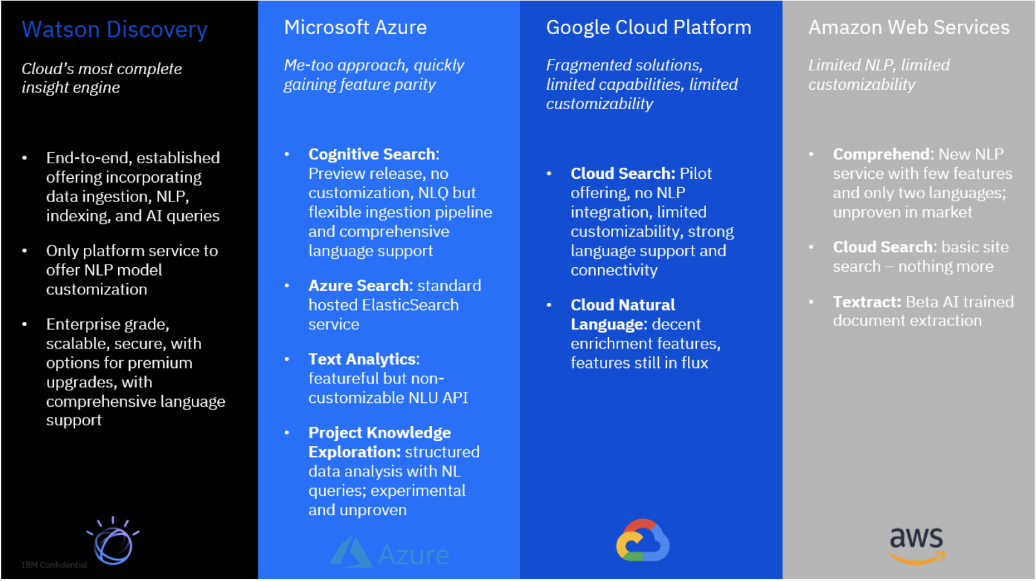
Leading Competitors
Introduction to Text Analytics
Competitive – Watson Discovery

Slide 46
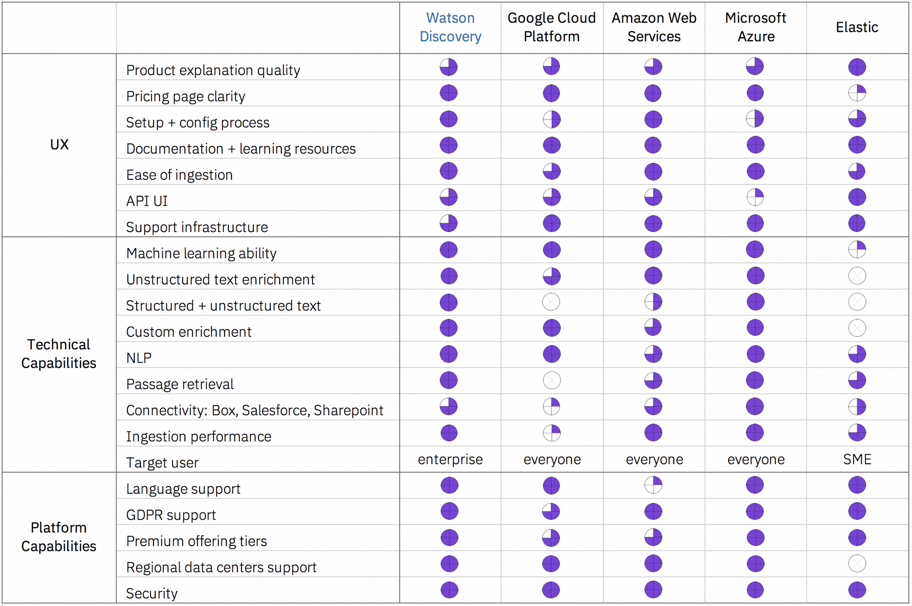
Features Landscape
Introduction to Text Analytics
Competitive – Watson Discovery

Slide 47
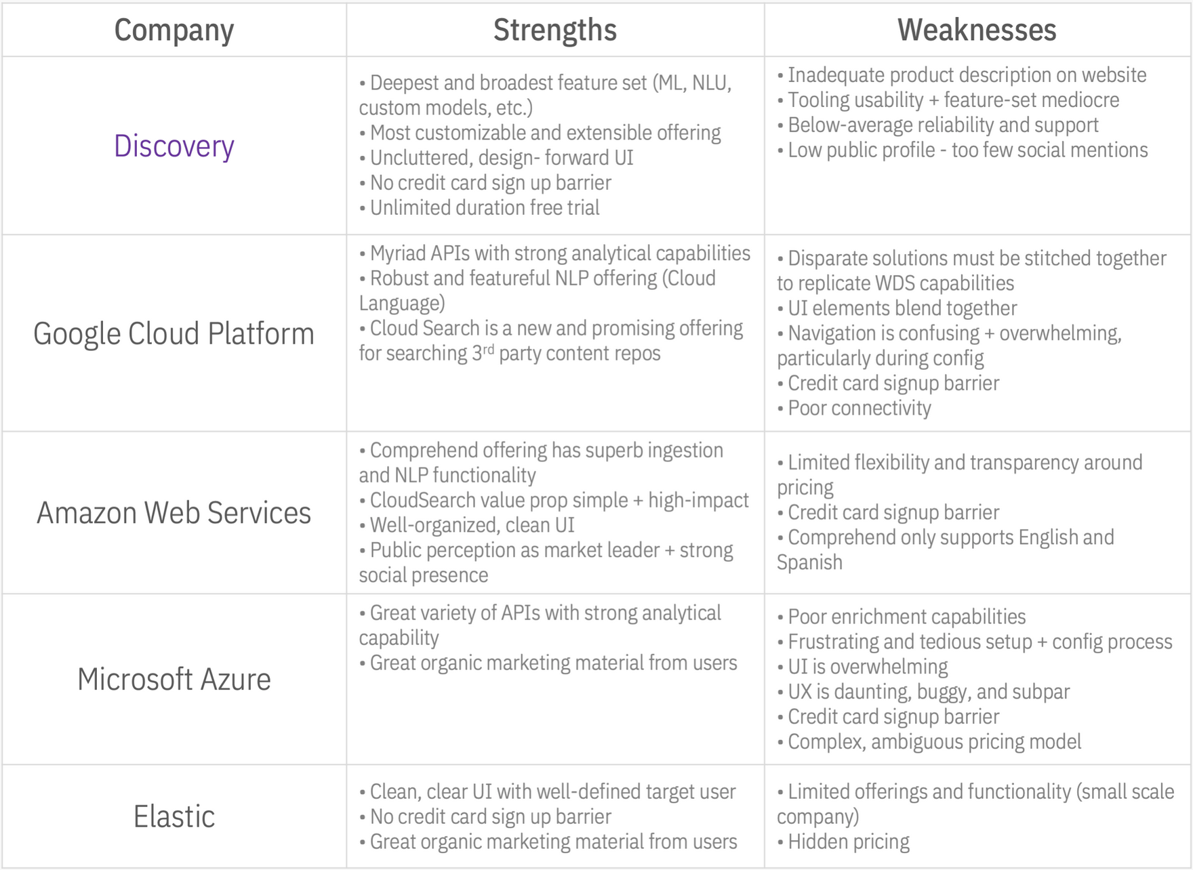
Strengths & Weaknesses
Introduction to Text Analytics
Competitive – Watson Discovery
Notes:
Links:
WDS Competitive Analysis Deep Dive Consolidated Battle Cards Deck Competitive Analysis Video Microsoft Azure Cognitive Services Deep Dive

